Slide 1

Mapping Inputs to Outputs: Parametric ML Model
Professor Bo Liu
James Watt School of Engineering

Slide 2

Select ML algorithms
Represent data: the data should be translated to the language that ML algorithms can understand → Data types/encoding
Select ML algorithms
Evaluate output: prediction errors
Data representation
Select ML algorithms
Model training
Model evaluation

Slide 3
Parametric models
Parametric models simplify the model to a known form (e.g., a line) of function that defines the relationship between inputs and outputs.
linear regression, logistic regression, simple neural network, etc.
Pros:
  Often Explainable: easy to understand and interpret the results.
Cons:
  Sometimes Constrained: highly constrained to the specified form.
  Maybe Poor Fit: sometimes hard to match the underlying mapping function.

Slide 4
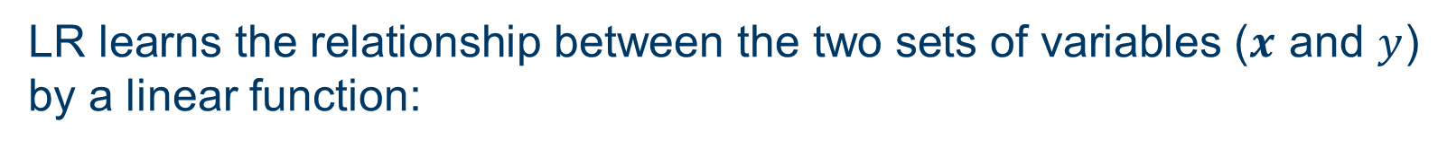
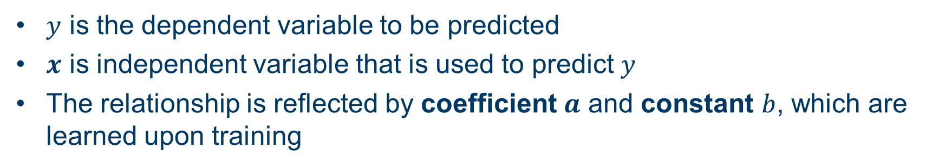

Parametric model: linear regression (LR)
LR learns the relationship between the two sets of variables ($x$ and $y$) by a linear function:
$$y=ax+b$$
  $y$ is the dependent variable to be predicted
  $x$ is independent variable that is used to predict $y$
  The relationship is reflected by coefficient $a$ and constant $b$, which are learned upon training
LR maps one or more numerical inputs to a numerical output.

Slide 5
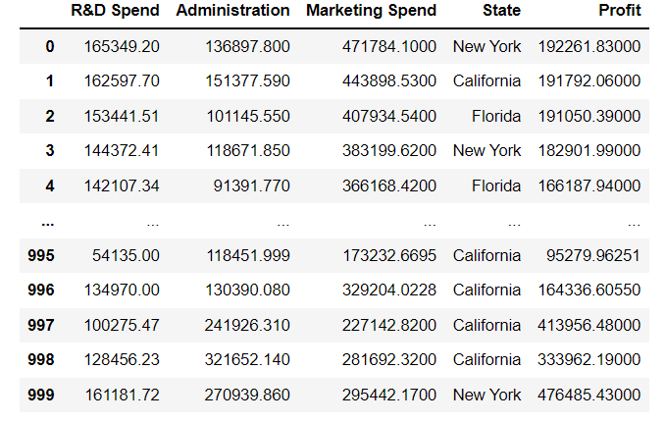
Parametric model: linear regression
LR example: financial prediction
Given R&D spend, administration spend, and the location (state) of a company
How much profit can the company expect to make?

Slide 6
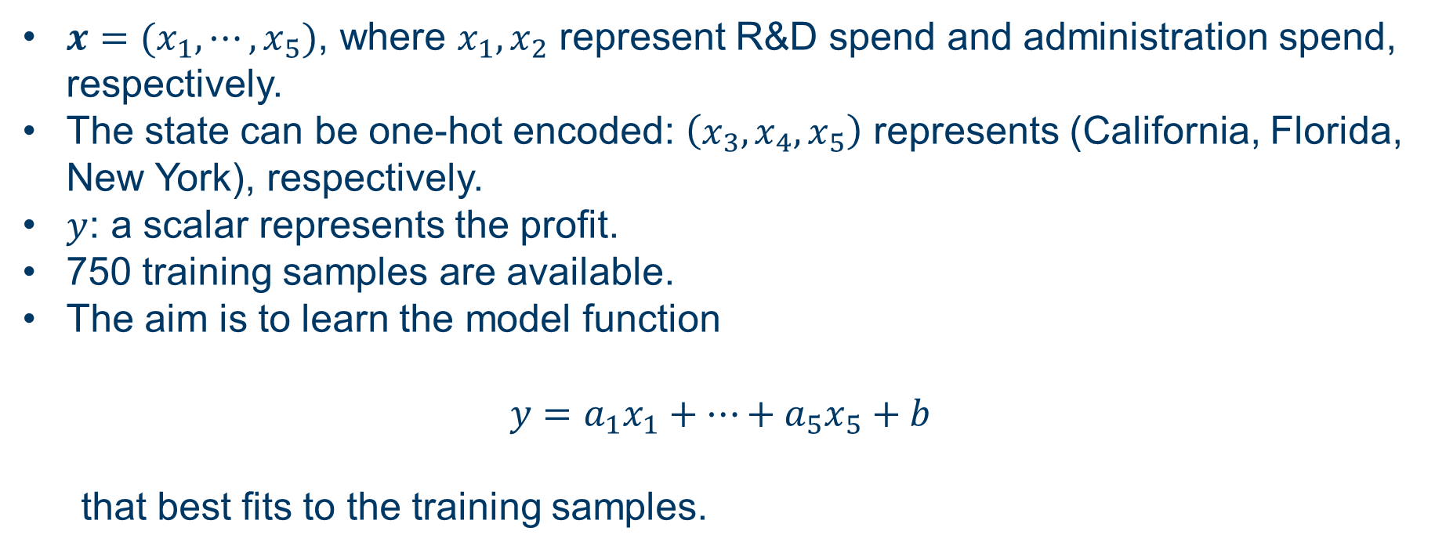
Parametric model: linear regression
LR example: financial prediction
$x=(x_{1},⋯,x_{5})$, where $x_{1},x_{2}$ represent R&D spend and administration spend, respectively.
The state can be one-hot encoded: $\left(x_{3}, x_{4},x_{5}\right)$ represents (California, Florida, New York), respectively.
$y$: a scalar represents the profit.
750 training samples are available.
The aim is to learn the model function
$$y=a_{1}x_{1}+⋯+a_{5}x_{5}+b$$
  that best fits to the training samples.

Slide 7
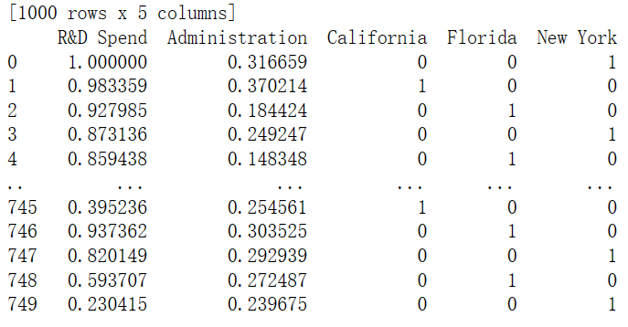
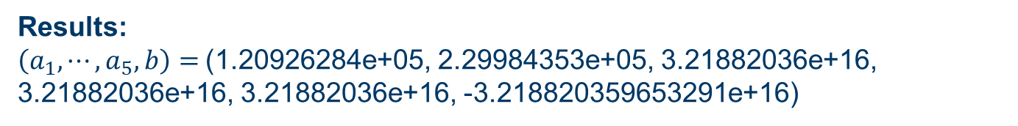
Parametric model: linear regression
LR example: financial prediction
Normalization of the numerical data and one-hot encoding of categorical data
Results:
$\left(a_{1}, ⋯, a_{5}, b\right)=$(1.20926284e+05, 2.29984353e+05, 3.21882036e+16,
3.21882036e+16, 3.21882036e+16, -3.218820359653291e+16)

Slide 8
Parametric model: linear regression
Advantages of LR
Performs well when there is a linear relation between dependent and independent variables.
Easier to implement, interpret and efficient to train.
Drawbacks of LR
Valid only when the assumption of linearity between dependent and independent variables is true
Sensitive to outliers

Slide 9




Thanks!
#UofGWorldChangers
@UofGlasgow

